Slide 1
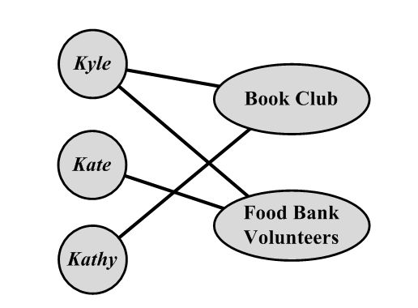
What is an affiliation network?
In social network analysis affiliation networks link persons to other kinds of entities (such as “groups”)
  Most commonly groups or events
The are composed of:
  A set of individuals
  A set of groups
  A set of relations linking individuals to groups
  Subsets of individuals belonging to the same groups

Slide 2
What is an affiliation network?
Types of affiliation networks that have been studied in the literature include:
  Hollywood actors and the movies that they make
  CEOs and the board of directors that they sit on
  Community leaders and the associations they belong to
  Broadway talent and the projects that they collaborate on
  Scientific papers and the people they cite

Slide 3
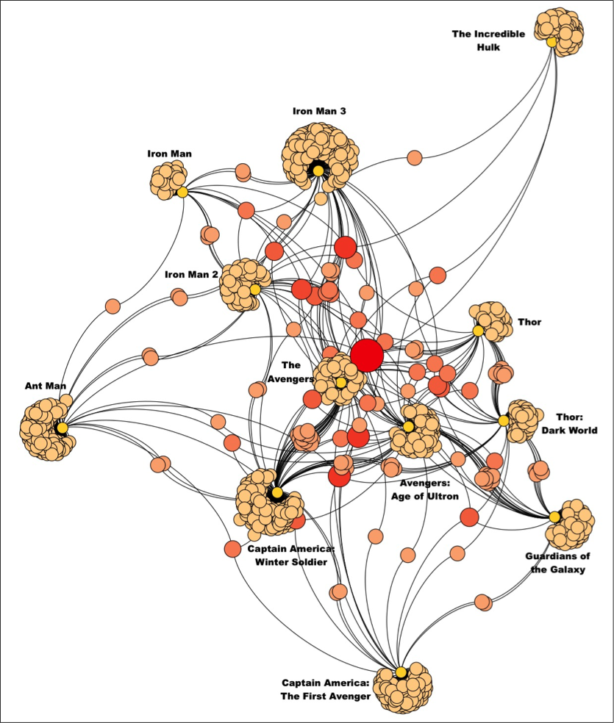
What is an affiliation network?
Types of affiliation networks that have been studied in the literature include:
  Hollywood actors and the movies that they make
  CEOs and the board of directors that they sit on
  Community leaders and the associations they belong to
  Broadway talent and the projects that they collaborate on
  Scientists and the journal they publish in

Slide 4
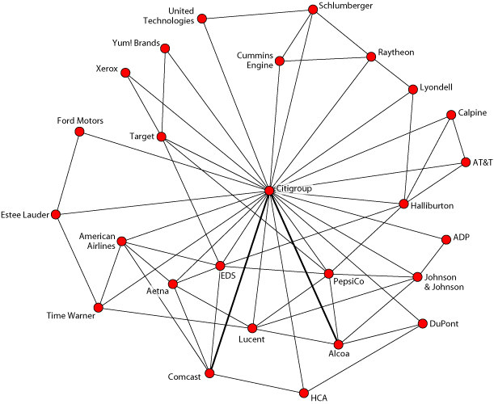
What is an affiliation network?
Types of affiliation networks that have been studied in the literature include:
  Hollywood actors and the movies that they make
  CEOs and the board of directors that they sit on
  Community leaders and the associations they belong to
  Broadway talent and the projects that they collaborate on
  Scientists and the journal they publish in

Slide 5
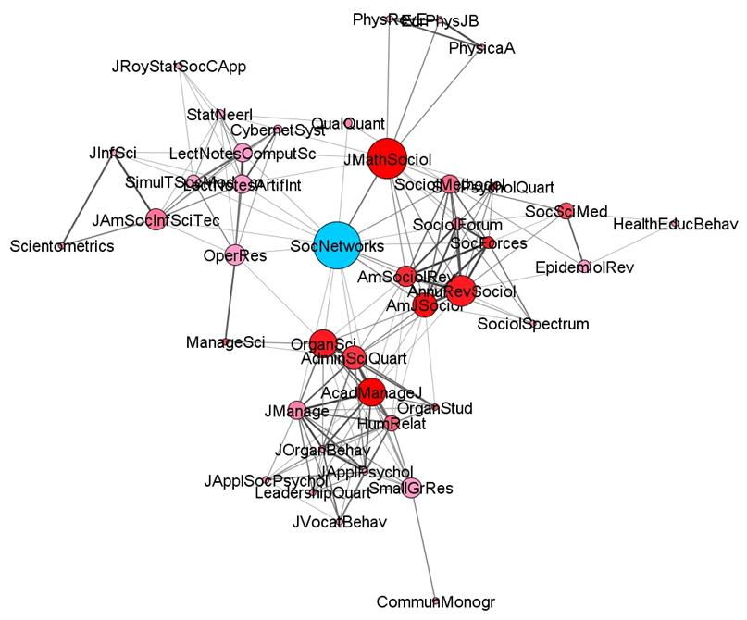
What is an affiliation network?
Types of affiliation networks that have been studied in the literature include:
  Hollywood actors and the movies that they make
  CEOs and the board of directors that they sit on
  Community leaders and the associations they belong to
  Broadway talent and the projects that they collaborate on
  Scientists and the journal they publish in

Slide 6
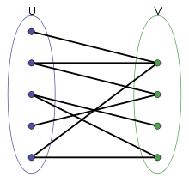
Graph theory: Bipartite graphs
In social networks analysis affiliation networks can be represented as bipartite graphs
A bipartite graph is characterized by:
  Two set of vertices (g) and (h)
  A set of relations (e) linking vertices from set g to vertices from set h
  Vertex sets g and h are disjoint
    This means they don’t share members
  Edges link vertices between sets but not within sets
g h

Slide 7
Bipartite graphs: Matrix representation
Bipartite graphs are usually represented using an affiliation matrix A of dimensions g x h, where
  g is the number of persons (rows)
  h is the number of groups (columns)
  A_{ik} = 1 if actor i is affiliated with event k and zero otherwise
 | Debate Club | Glee Club | Student Council | Swim Team | Track Team
Janice | 1 | 0 | 0 | 1 | 0
Kent | 0 | 0 | 0 | 1 | 1
Lena | 1 | 0 | 1 | 0 | 0
Max | 1 | 1 | 0 | 0 | 1
Olive | 0 | 1 | 1 | 0 | 1
Pat | 1 | 0 | 0 | 0 | 1

Slide 8
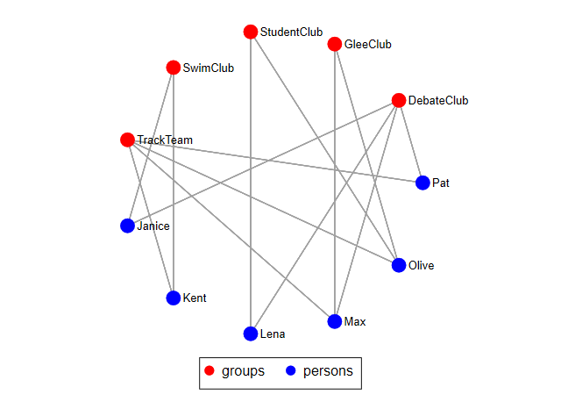
Bipartite graphs: Matrix representation
 | Debate Club | Glee Club | Student Council | Swim Team | Track Team
Janice | 1 | 0 | 0 | 1 | 0
Kent | 0 | 0 | 0 | 1 | 1
Lena | 1 | 0 | 1 | 0 | 0
Max | 1 | 1 | 0 | 0 | 1
Olive | 0 | 1 | 1 | 0 | 1
Pat | 1 | 0 | 0 | 0 | 1

Slide 9
Matrix Operations: The Transpose
The transpose (' or ^{T}) of a matrix reverses the row and column dimensions.
  A_{ij}^{T}= A_{ji}
So a g x h matrix becomes an h x g matrix
A
A^{T}
a | b
c | d
e | f
a | c | e
b | d | f

Slide 10
 | Debate Club | Glee Club | Student Council | Swim Team | Track Team
Janice | 1 | 0 | 0 | 1 | 0
Kent | 0 | 0 | 0 | 1 | 1
Lena | 1 | 0 | 1 | 0 | 0
Max | 1 | 1 | 0 | 0 | 1
Olive | 0 | 1 | 1 | 0 | 1
Pat | 1 | 0 | 0 | 0 | 1
 | Janice | Kent | Lena | Max | Olive | Pat
Debate Club | 1 | 0 | 1 | 1 | 0 | 1
Glee Club | 0 | 0 | 0 | 1 | 1 | 0
Student Council | 0 | 0 | 1 | 0 | 1 | 0
Swim Team | 1 | 1 | 0 | 0 | 0 | 0
Track Team | 0 | 1 | 0 | 1 | 1 | 1
A_{6 x 5}
A^{T}_{5 x 6}

Slide 11
Matrix Operations: Matrix Multiplication
The matrix multiplication (x) of two matrices involves all elements of the matrix, and will often result in a matrix of new dimensions.
  In general, to be conformable, the inner dimensions (red) of both matrices must match.
  The resulting matrix has the dimensions a x b, where a is the outer dimension (green) of the left multiplier and b is the outer dimension (blue) of the right multiplier. So:
A_{3 x 2} x A_{2 x 3} = C_{3 x 3}
A_{3 x 2} x B_{3 x 4} = Not defined
Inner dims. match
Inner dimensions do not match
Outer dims.

Slide 12
Matrix Operations: Matrix Multiplication
The matrix multiplication (x) of two matrices involves all elements of the matrix, and will often result in a matrix of new dimensions.
  In general, to be conformable, the inner dimensions (red) of both matrices must match.
  Turns out that the product of any matrix A by its transpose is defined!
  So is the product of the transpose times the original matrix!
A_{3 x 2} x A^{T}_{2 x 3} = C_{3 x 3}
A^{T}_{2 x 3} x A_{3 x 2} = C_{2 x 2}
Inner dims. match
Inner dims. match
Outer dims.
Outer dims.

Slide 13
From two mode to one-mode and back
What happens when you multiply an affiliation A matrix by its transpose A^{T}?
If A is g x h and g is the number of people and h is the number of events:
  A_{g x h} x A^{T}_{h x g} = C _{g x g}
C is a g x g (square) co-membership matrix
c_{ij} is the number of common group memberships shared by person i and person j
The c_{ii} (diagonal) entries give the number of total memberships held by person i
  First discovered by Breiger (1974)

Slide 14
From two mode to one-mode and back
What happens when you multiply the transpose of an affiliation matrix A^{T} by the original A?
If A is g x h and g is the number of people and h is the number of events:
  A^{T}_{h x g} x A_{g x h} = O _{h x h}
E is a h x h (square) group-overlap matrix
o_{ij} is the number of shared members between group i and group j
The o_{ii} (diagonal) entries give the size of group i
  First discovered by Breiger (1974)

Slide 15
Network theory: The duality of persons and groups
The first detailed treatment of affiliation networks is due to Breiger (1974) in a now classic paper
  The relations between entities are co-constituted by their relations to another set of entities (Simmel 1971)
  Affiliation networks can be used to formalize a classic notion of how people indirectly relate to one another via their group memberships
Duality
  Persons are related by the set of group memberships they have in common
  Events are related by the set of persons who participate in both

Slide 16

Graph theory: Weighted graphs
Often it is useful to associate numerical values with the edges (uv) of a graph:
  This is called the edge weight (w_{uv})
  This may be used to represent:
    the strength of the relationship joining two people
    the amount of something (e.g. information) that flows via the ties
Graphs that featured edge weights are called weighted (valued) graphs:
  Binary graphs can be thought of as a constrained case of weighted graphs

Slide 17
One mode projections as weighted graphs
One mode projections of two mode networks can be thought of as matrix representations of weighted graphs
  People are linked to one another is they share memberships
    The more shared memberships the stronger the link (w_{ij})
  Groups are linked to one another if they share members
    The more shared members the stronger the link (w_{ij})
  We can binarize the weighted one-mode representation to get back to simple graphs
    c*_{ij} = 1 if c_{ij} > ϴ, else c*_{ij} = 0; o*_{ij} = 1 if o_{ij} > ϴ, else o*_{ij} = 0
      Note that co-membership and overlap relations are symmetric!
  We can then calculate degree, betweenness, closeness, eigenvector, and other indices of vertex prominence and position
    Loss of information but gains in simplicity (Borgatti and Everett 2013)

Slide 18
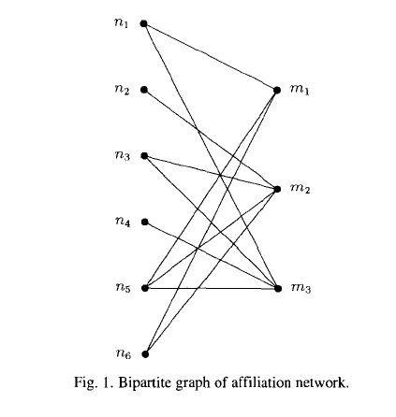
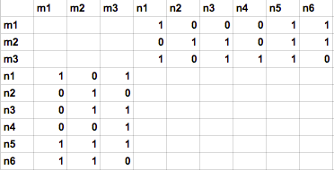
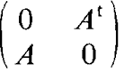
The bipartite graph
An affiliation network may also be represented as a bipartite matrix X^{NM} of dimensions (g + h)
Because links exist only across the two types of vertices, the bipartite graph of an affiliation network has two "zero blocks"

Slide 19
 | Debate Club | Glee Club | Student Council | Swim Team | Track Team | Janice | Kent | Lena | Max | Olive | Pat
Janice | 1 | 0 | 0 | 1 | 0 | 0 | 0 | 0 | 0 | 0 | 0
Kent | 0 | 0 | 0 | 1 | 1 | 0 | 0 | 0 | 0 | 0 | 0
Lena | 1 | 0 | 1 | 0 | 0 | 0 | 0 | 0 | 0 | 0 | 0
Max | 1 | 1 | 0 | 0 | 1 | 0 | 0 | 0 | 0 | 0 | 0
Olive | 0 | 1 | 1 | 0 | 1 | 0 | 0 | 0 | 0 | 0 | 0
Pat | 1 | 0 | 0 | 0 | 1 | 0 | 0 | 0 | 0 | 0 | 0
Debate Club | 0 | 0 | 0 | 0 | 0 | 1 | 0 | 1 | 1 | 0 | 1
Glee Club | 0 | 0 | 0 | 0 | 0 | 0 | 0 | 0 | 1 | 1 | 0
Student Council | 0 | 0 | 0 | 0 | 0 | 0 | 0 | 1 | 0 | 1 | 0
Swim Team | 0 | 0 | 0 | 0 | 0 | 1 | 1 | 0 | 0 | 0 | 0
Track Team | 0 | 0 | 0 | 0 | 0 | 0 | 1 | 0 | 1 | 1 | 1

Slide 20
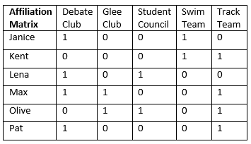
Centrality in affiliation networks
Good news. Degree is still degree! For people:
  Row sums of affiliation matrix (A) is the number of memberships
  Row or column sums of weighted co-membership (C) matrix is the number of potential non-unique contacts
  Row or column sums of binarized co-membership (C*) matrix is the number of potential unique contacts of a person by dint of sharing a membership
    c*_{ij} = 1 if c_{ij} ≥ 1
2
2
2
3
3
2

Slide 21
Centrality in affiliation networks
Good news. Degree is still degree! For groups:
  Column sums of affiliation matrix (A) is the size of the group
  Row or column sums of weighted group-overlap (O) is the number of memberships of people who belong to the group
  Row or column sums of binarized group-overlap (O*) matrix is the number of unique groups the focal group is connected to by dint of sharing at least one member
    o*_{ij} = 1 if o_{ij} ≥ 1
4
2
2
2
4

Slide 22
What does this means substantively?
Board interlock network (people by boards):
  For people:
    Centrality in affiliation matrix is belonging to a lot of boards
    Centrality in binarized co-membership matrix is the number of other board members encountered by virtue of sitting on a given number of boards

Slide 23
What does this means substantively?
Board interlock network (people by boards):
  For boards:
    Centrality in affiliation matrix is the size of the board
    Centrality in raw co-membership matrix means board is composed of people who also sit on a lot of other boards

Slide 24
What does this means substantively?
Citation network (authors by journals):
  For authors:
    Centrality in affiliation matrix means an author who publishes in lots of different journals
    ij^{th} cell in weighted co-membership matrix tendency of authors i and j to publish in the same journals

Slide 25
What does this means substantively?
Citation network (authors by journals):
  For journals:
    Centrality in affiliation matrix means journal to whom lots of authors contribute
    Centrality in weighted event-overlap matrix means that a journal contributors also tend to publish in lots of other journals

Slide 26


Eigenvector centrality in affiliation networks
The eigenvector centralities of actors and events may be defined in the same way
  Actors gain centrality from participating in central events
  Events gain centrality when highly central persons participate in them

Slide 27


Eigenvector centrality in affiliation networks
The eigenvector centralities of actors and events may be defined in the same way
  Eigenvector centralities of two mode networks explicitly incorporates the duality between actor and event centralities:

Slide 28
Closeness
Distances between
  Actor and other actors
  Actor to all events
For an actor closeness centrality is a function of minimal distances from
  any of its events to other actors
  any of its events to other events
For an event, closeness centrality is a function of minimal distances from
  its actors to other actors
  its actors to other events
Notes:
Look at Sum d(i,k) n2 vs. n5
*

Slide 29
Betweenness
Actors always on geodesics between events
  Events always on geodesics between actors
An event gains betweenness centrality when pairs of its members only meet through that event
  (i.e. its actors belong to no other events)
An actor gains betweenness centrality when it is the only actor that is affiliated with a pair of events
  (i.e. the actor is the only member of the event)
Notes:
For an event: irony, if most members not in any other events, higher betweenness centrality, i.e. non-central actors create high event betweenness centrality
For an actor, if it belongs to an event with only one member (it), the actor gains betw centrality
LIKE actors bridge events and have more centrality to the extent that only they do so
events bridge actors and more more centrality to the extent that only the event does so
Events: Look at n2 to n6, must go through M2, which gives M2 higher centrality
Actors: Look at N5 vs. N4 (or N2).
N5 connects all three events, while N4 and N2 connect none (because they only belong to one event).
*

